Slide 1
Katrin Seppel
Eesti Kultuurkapital

Slide 2
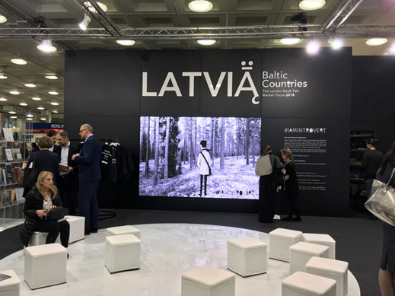
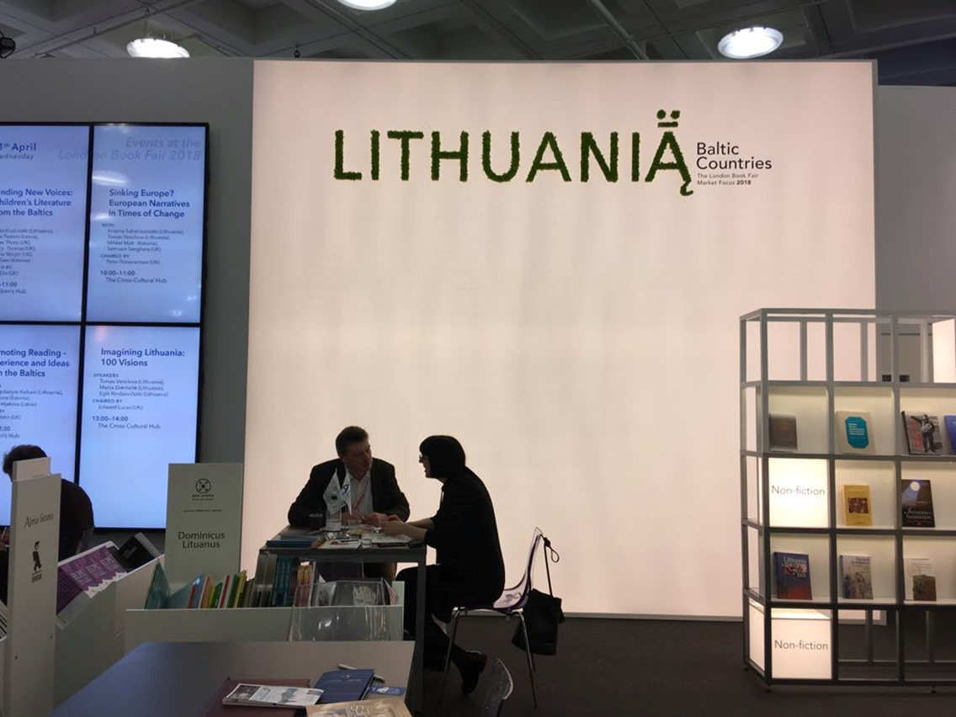
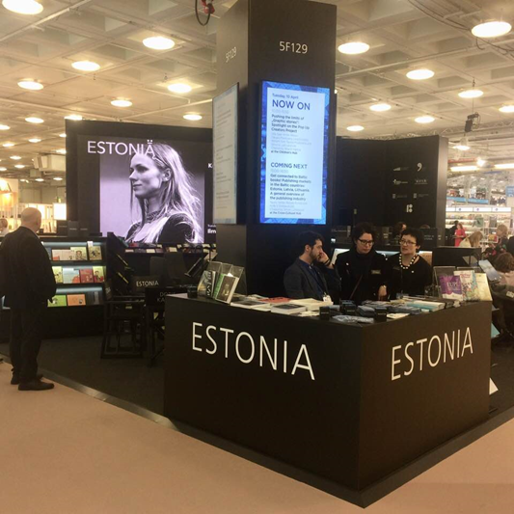
Balti Kultuurifond
Baltic Culture Fund promotes cultural cooperation between Baltic States, in order to strengthen the internationalisation of Estonian, Latvian and Lithuanian culture through joint cultural events.
The Fund started operating 1 January 2019.

Slide 3
Budget ja coordination of the Fund
Fund’s annual budget is 300,000 euros
Each Baltic country will contribute 100,000 euros to the Fund annually.
The Fund is administrated by national cultural endowments on a three-year rotation basis; the Cultural Endowment of Estonia is the first to coordinate the Fund’s activities.
Estonia - Eesti Kultuukapital (operating the Fund 2019-2021)
Latvia - Valsts kultūrkapitāla fonds (operating the Fund 2022-2024)
Lithuania - Lietuvos kultūros taryba (operating the Fund 2025-2027)
The working language of the programme is English
The Fund also accepts donations. The Nordic Council of Ministers donated 100,000 euros to the Baltic Culture Fund to organise joint cultural events of Baltic states in Denmark, Finland, Iceland, Norway and Sweden

Slide 4
Baltic Culture Fund supports:
professional events and projects in architecture, visual art, design, literature, sound art, performing arts, libraries, museums and archives. The Fund also welcomes interdisciplinary projects.
The Fund especially supports new and one-off cultural events outside the Baltic countries, such as concerts, exhibitions, festivals, performances, international events with a Baltic focus, and showcases and forums promoting the internationalisation of culture.
In exceptional cases, events in the Baltics can be supported if they have a very distinct international dimension with a Baltic focus.

Slide 5
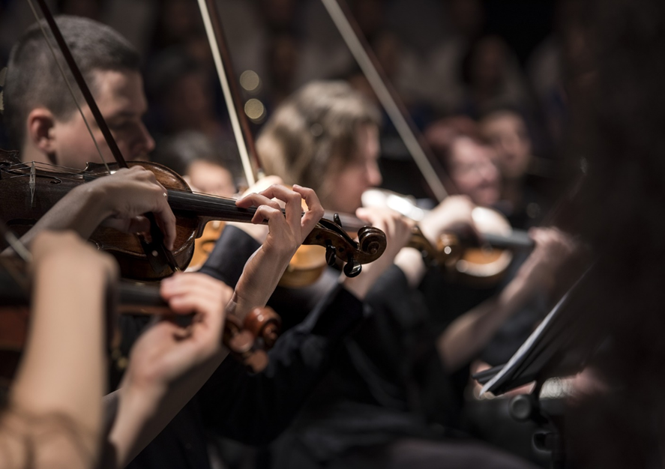
Who can apply?
Only legal persons (organisation or institution) from Estonia, Latvia or Lithuania can apply
Each project must have one main partner and other partners from othe Baltic states
The allocation of the grants are limited between 25 000 and 100 000 euros
Grants are awarded once a year, the deadline is 20 May (to be changed)
Self- or co-financing at least 20% of the budget.

Slide 6
Expert committee
Applications are evaluated by a 6-member committee:
Representatives from Estonia:
Kai Lobjakas, art historian, director of Estonian Museum of Design and Applied Art
Ragnar Siil, expert on cultural policies and cretive intustries
Representatives from Latvia:
Maris Jekabsons, restorer, Chairman of SCCF Cultural Heritage branch
Aiva Rozenberga, (former) director of the Latvian Institute
Representatives from Lithuania:
Elona Bajorinienė, theatre critic, former head of Vilnius European Capital of Culture 2009, current Dean of Faculty of Theatre and Film at Lithuanian Academy of Music and Theatre
Lolita Jablonskienė, contemporary art critic and curator, current Head of National Gallery of Art

Slide 7
First results
33 applications
12 applications from Estonia
12 applications from Lithuania
9 applications from Latvia
The most applications we got were from the fields of visual art, also music and dance.
Altogether 2,002118,76 euros were applied for – budget 400 000

Slide 8
Oven-fresh results and remarks from the expert committee
9 projects were supported, 6 +3 (in the Nordic countries)
Biggest grant amount 70 000 euros
Smallest 25 000 euros
NOTES
Read the statute!
Projects don’t meet the criteria to organise an event outside the Baltics.
Exceptional cases weren’t supported – not exceptional enough
Not non-recurrent/new events
Too high expectations on management fees
Budget not clear or realistic

Slide 9
Aitäh! Paldies! Ačiū!
https://kulka.ee/programmes/baltic-culture-fund

